Slide 1
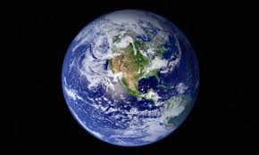
World Happiness

Slide 2

Team Members

Slide 3
World Happiness Reports
Examined the World Happiness Reports and want to share our findings
2015
2016
2017

Slide 4
World Happiness Reports
United Nations
Annual publication – initial report 2012
Ranks 156 countries by happiness levels
Income
Freedom
Trust
Health (Life Expectancy)
Social Support
Generosity
Help guide public policy

Slide 5
How Conducted
Sample of approximately 1,000 people per country
Survey asking people to score their happiness
Income
Freedom
Trust
Health (Life Expectancy)
Social Support
Generosity
Scale: Cantril Ladder
Top Step = Best Possible Life = 10
Bottom Step = Worst Possible Life = 0
Notes:
The rankings are based on answers to the main life evaluation question asked in the poll. This is called the Cantril ladder: it asks respondents to think of a ladder, with the best possible life for them being a 10, and the worst possible life being a 0.

Slide 6
Definition
Happiness is a state of well-being characterized by emotions ranging from contentment to intense joy.
Happiness is the feeling that comes over you when you know life is good and you cannot help but smile. It is the opposite of sadness.
Happiness is a unique sensation to each person.
Health
Family
Job
Material

Slide 7
Main Drivers of Happiness
Wealth
Family
Health (Life Expectancy)
Freedom

Slide 8
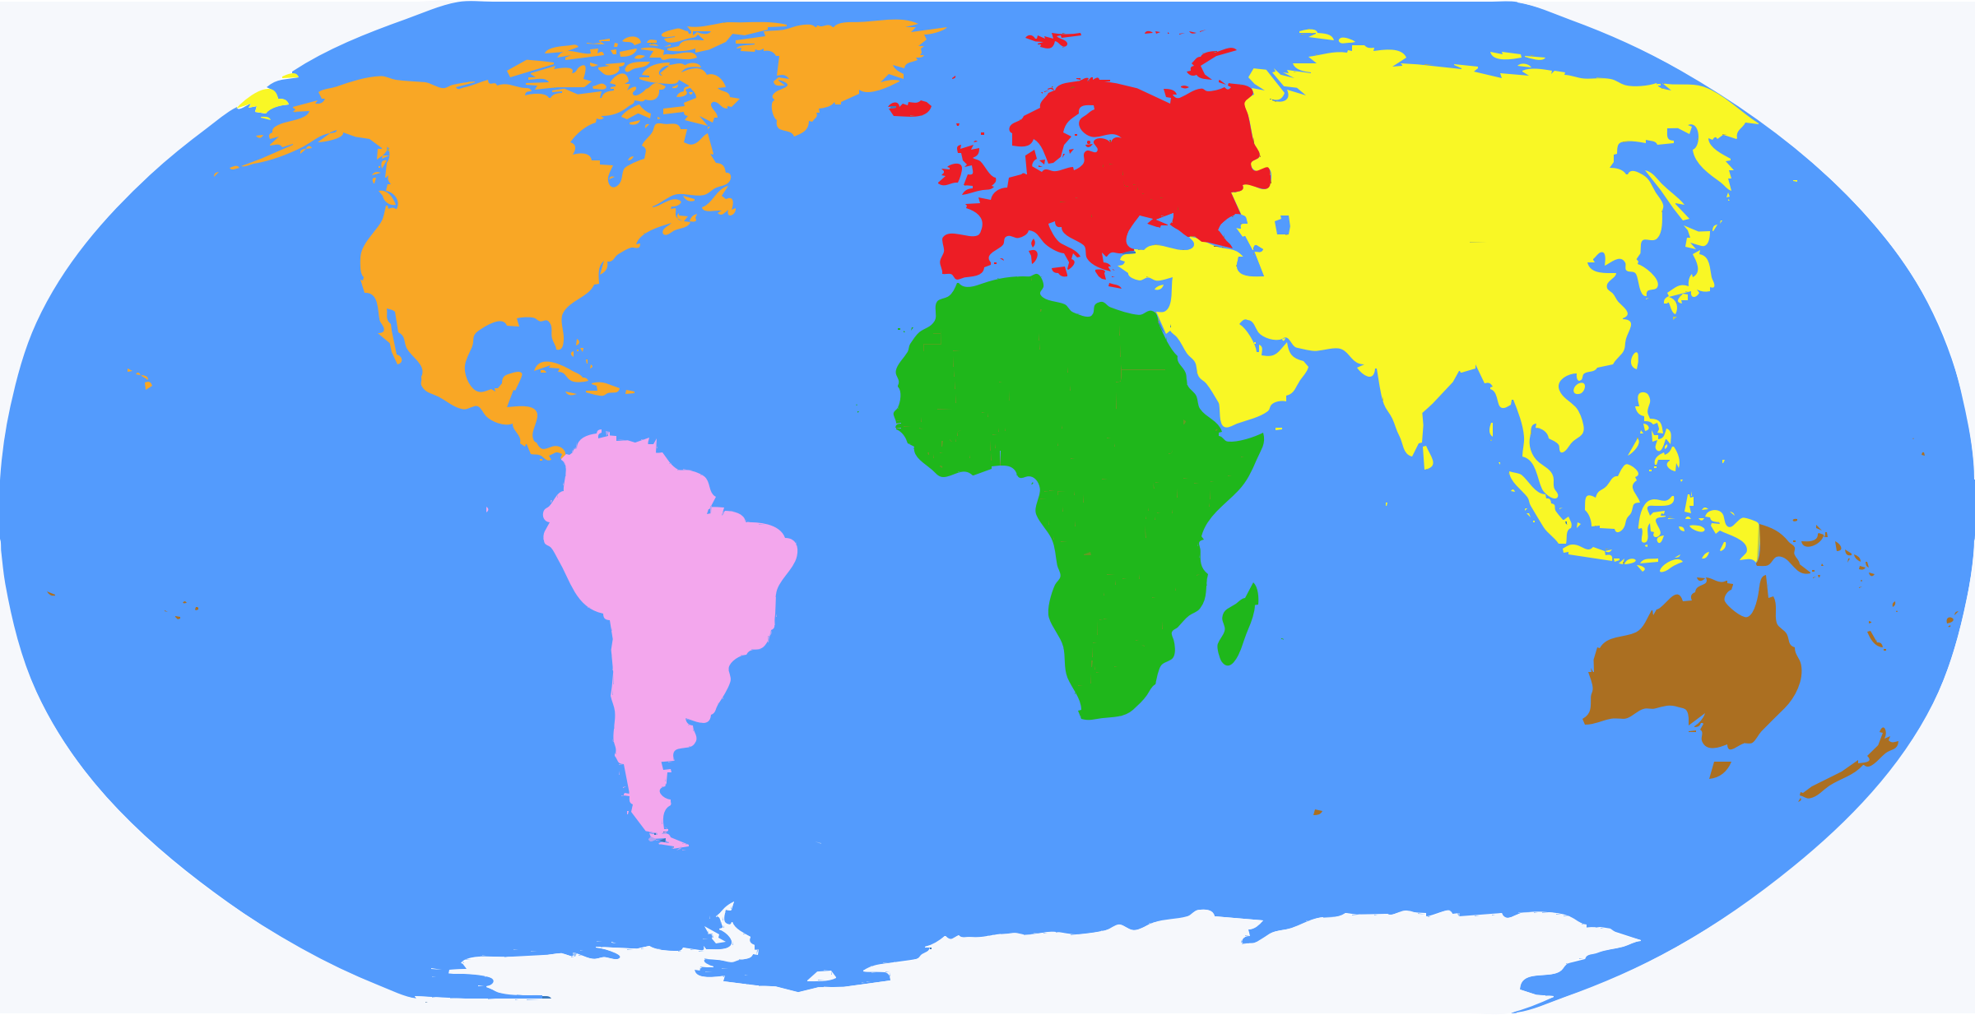
World Regions
5.33
6.69
7.27
5.41
5.63
4.58
4.20
5.32
6.14
7.28
Overall 5.34

Slide 9
Countries
Norway | 7.54
Denmark | 7.52
Iceland | 7.50
Switzerland | 7.49
Finland | 7.47
Philippines | 5.43
Serbia | 5.39
Jordan | 5.34
Hungary | 5.32
Jamaica | 5.31
Rwanda | 3.47
Syria | 3.46
Tanzania | 3.35
Burundi | 2.90
Central African Republic | 2.69

Slide 10



Wealth: GDP per Capita
Measure of total output of a country
Gross domestic product (GDP) $÷$ population of country
Demonstrates performance of countries

Slide 11
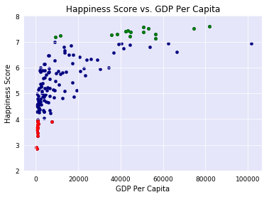
GDP per Capita
Spain
HS:6.3 GDPPC:$25K
Luxemburg
HS:6.9
GDPPC:$111K
USA
HS:7.1 GDPPC:$56K
Brundi
HS:2.9 GDPPC:$300

Slide 12
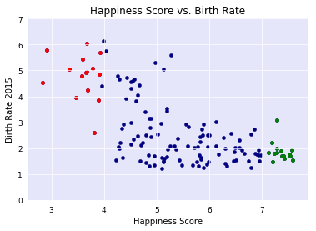
Family: Birth Rate
Chad
BR:6 HS:3.6
Zambia
BR:5 HS:5.1
Armenia
BR:1.6 HS:4.3
Switzerland
BR:1.5 HS:7.6

Slide 13
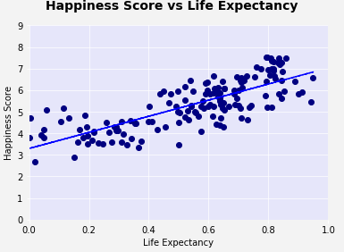
Health: Life Expectancy from Birth

Slide 14
Health: Life Expectancy from Birth
Norway | 82
Denmark | 81
Iceland | 83
Switzerland | 83
Finland | 81
Philippines | 69
Serbia | 75
Jordan | 74
Hungary | 76
Jamaica | 76
Rwanda | 67
Syria | 70
Tanzania | 65
Burundi | 57
Central African Republic | 51

Slide 15
Freedom: Forms of Government
Full Democracy - Citizens have direct and equal vote (e.g. Norway)
Flawed Democracy – Citizens elect representatives (e.g. USA)
Hybrid Regime – Blend of autocracy and democracy (e.g. China, Iran)
Authoritarian – Submission to authority (e.g. Cuba, Venezuela)

Slide 16
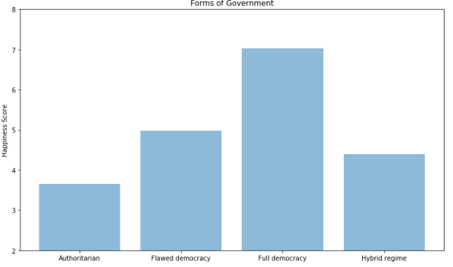
Freedom: Forms of Government

Slide 17
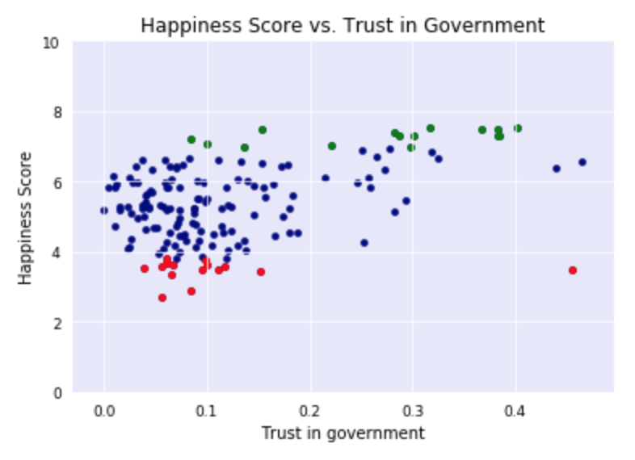
Freedom: Trust in Government

Slide 18
Summary
Wealth
Family
Health (Life Expectancy)
Freedom

Slide 19
Data Sets used in Project
Happiness scores by country from https://www.kaggle.com/unsdsn/world-happiness
GDP Per Capita by Country Data : World Bank open data sources : http://databank.worldbank.org/data/reports.aspx?
Fertility Rate Per Woman Data : World Bank open data sources : http://databank.worldbank.org/data/reports.aspx?

Slide 20
Questions?

